Slide 1
COURSE CODE:
INFT 352
TITLE:
Advanced Web Engineering and Application With PHP
LECTURER/ INSTRUCTOR: P.M SARFO

Slide 2
PHP FILE HANDLING AND UPLOADING

Slide 3
In PHP, File handling is the process of interacting with files on the server, such as reading files, writing to a file, creating new files, or deleting existing ones.
File handling is essential for applications that require the storage and retrieval of data, such as logging systems, user-generated content, or file uploads.

Slide 4
Types of File Operations in PHP
Several types of file operations can be performed in PHP:
Reading Files: PHP allows you to read data from files either entirely or line by line.
Writing to Files: You can write data to a file, either overwriting existing content or appending to the end.
File Metadata: PHP allows you to gather information about files, such as their size, type, and last modified time.
File Uploading: PHP can handle file uploads via forms, enabling users to submit files to the server.

Slide 5
Common File Handling Functions in PHP
fopen() - Opens a file
fclose() - Closes a file
fread() - Reads data from a file
fwrite() - Writes data to a file
file_exists() - Checks if a file exists
unlink() - Deletes a file

Slide 6
Opening and Closing Files
Before you can read or write to a file, you need to open it using the fopen() function, which returns a file pointer resource.
Once you're done working with the file, you should close it using fclose() to free up resources.

Slide 7
<?php
// Open the file in read mode
$file = fopen("gfg.txt", “a+");
if ($file) {
echo "File opened successfully!";
fclose($file); // Close the file
} else {
echo "Failed to open the file.";
}
?>

Slide 8
File Modes in PHP
Files can be opened in any of the following modes:
"w" – Opens a file for writing only. If the file does not exist, then a new file is created, and if the file already exists, then the file will be truncated (the contents of the file are erased).
"r" – File is open for reading only.
"a" – File is open for writing only. The file pointer points to the end of the file. Existing data in the file is preserved.

Slide 9
"w+" – Opens file for reading and writing both. If the file does not exist, then a new file is created, and if the file already exists, then the contents of the file are erased.
"r+" – File is open for reading and writing both.
"a+" – File is open for write/read. The file pointer points to the end of the file. Existing data in the file is preserved. If the file is not there, then a new file is created.
"x" – New file is created for write only.

Slide 10
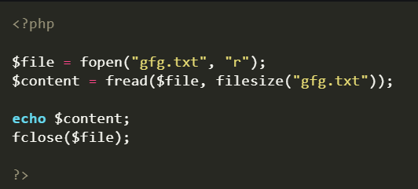
Reading from Files
There are two ways to read the contents of a file in PHP. These are -
1. Reading the Entire File
You can read the entire content of a file using the fread() function or the file_get_contents() function.

Slide 11
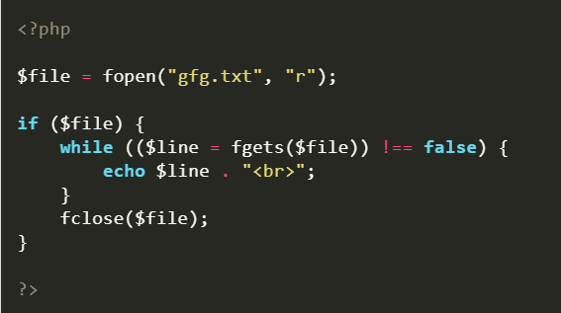
2. Reading a File Line by Line
You can use the fgets() function to read a file line by line.

Slide 12
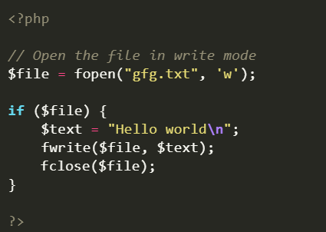
Writing to Files
You can write to files using the fwrite() function. It writes data to an open file in the specified mode.

Slide 13
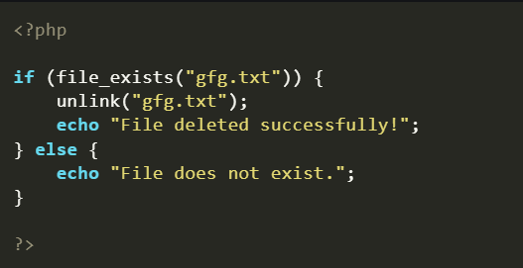
Deleting Files
Use the unlink() function to delete the file in PHP.

Slide 14
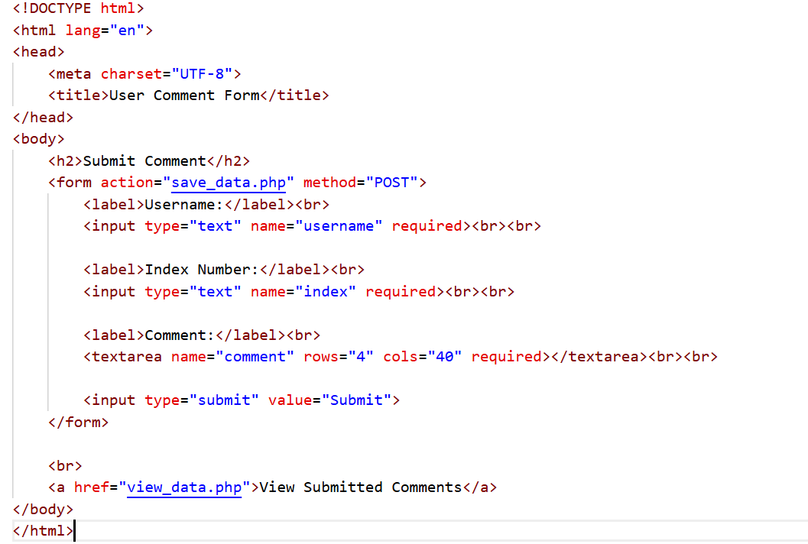
Notes:
<!DOCTYPE html>
<html lang="en">
<head>
<meta charset="UTF-8">
<title>User Comment Form</title>
</head>
<body>
<h2>Submit Comment</h2>
<form action="save_data.php" method="POST">
<label>Username:</label><br>
<input type="text" name="username" required><br><br>
<label>Index Number:</label><br>
<input type="text" name="index" required><br><br>
<label>Comment:</label><br>
<textarea name="comment" rows="4" cols="40" required></textarea><br><br>
<input type="submit" value="Submit">
</form>
<br>
<a href="view_data.php">View Submitted Comments</a>
</body>
</html>

Slide 15
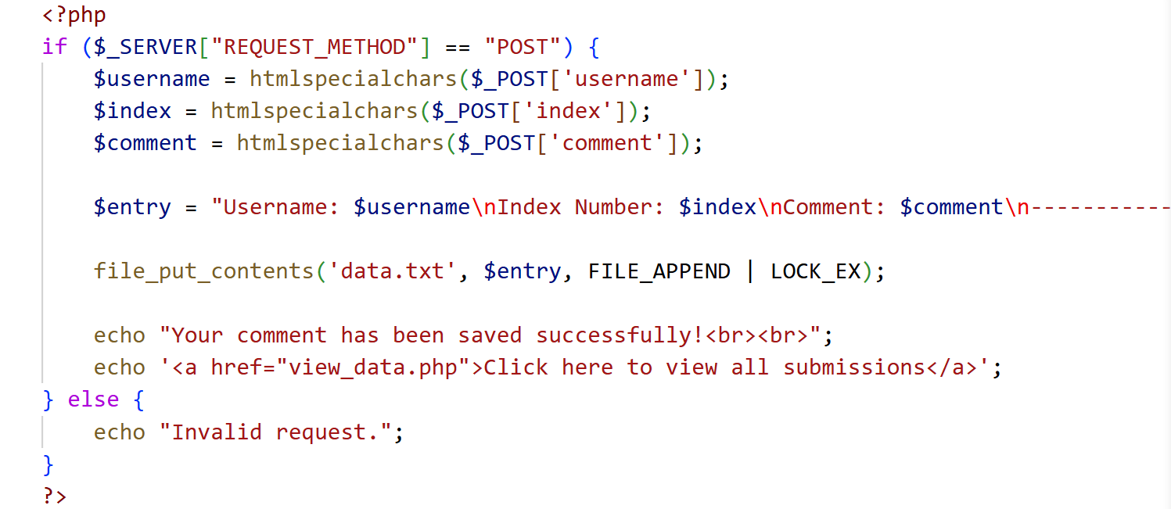
save_data PHP File

Slide 16
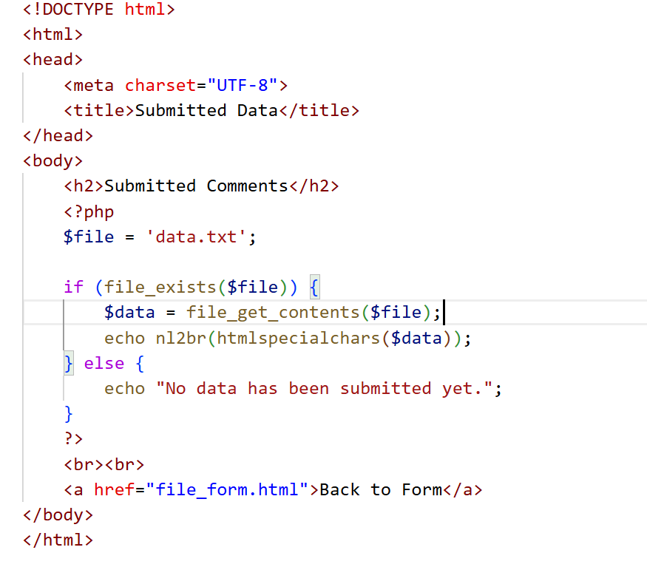
view_data PHP File

Slide 17
PHP | Uploading File

Slide 18
File uploads are essential for many modern web apps, letting users share various online content.
Developers frequently implement this feature across various applications, so understanding it is crucial.
Uploading files in PHP involves using client-side code such as HTML to allow users select a file, and PHP on the server-side to handle the upload to save it on the server or for processing.

Slide 19
PHP has a useful set of functions for working with file uploads securely and efficiently, such as finfo and the $_FILES superglobal variable.
Uploading a file in PHP involves two main components: a client-side HTML form and a server-side PHP script.
When a user selects a file and submits the form, the file is temporarily stored on the server, then we can use a PHP script to move it to a permanent location.

Slide 20
Before implementing file uploads in PHP, we need to confirm if it’s enabled.
We can check this in the php.ini configuration file.
By default, most PHP installations (like XAMPP, Laragon, or WAMP) already have file uploads enabled in the php.ini file so you don’t have to manually configure it yourself.

Slide 21
Alternatively, you can run the following code in a .php file to check if file uploads is enabled:
<?php
phpinfo();
?>
This will open a web page in the browser. Search for file_uploads on the page and check if its value is set to On.

Slide 22
Create HTML Form For File Uploading
To allow users to upload files, we need a simple HTML form that uses the POST method and multipart/form-data encoding to send the uploaded file to the server.
Create a upload.html file in your project root directory and add the following code to it:

Slide 23
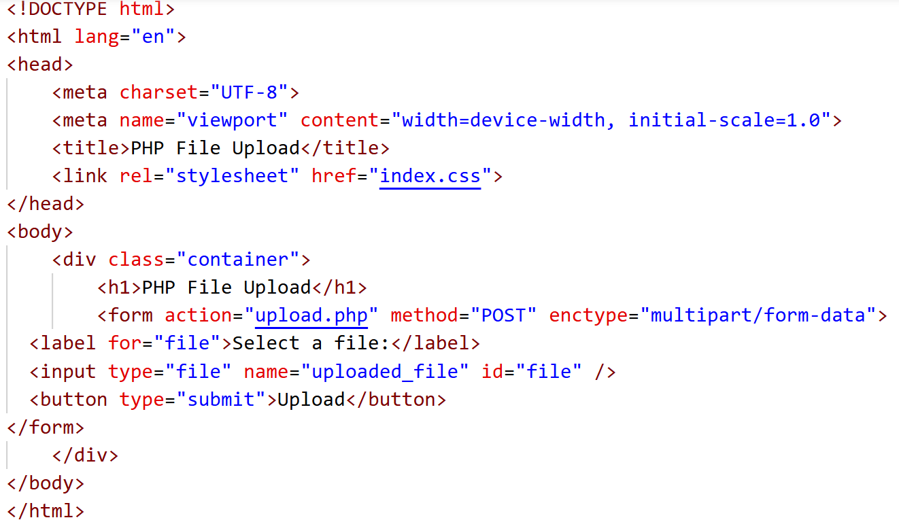

Slide 24
action="upload.php": This specifies where to send the form-data when the form is submitted, in this case, upload.php (we’ll create this file in a moment).
method="POST": This sets an HTTP POST method which is required for file uploads. It tells the PHP server we’re sending some data to it.
enctype="multipart/form-data": This tells the browser to send file data in the correct format so the PHP script can understand and process it correctly.
<input type="file">: This allows the user to upload one file from their device storage.
name="uploaded_file": The name attribute allows PHP to identify the uploaded file in the $_FILES superglobal.

Slide 25
PHP Script to Handle File Upload
Create a file named upload.php in the same directory as the upload.html file that will handle file uploads. The PHP script will check for upload errors, move the file to a safe location, and respond with a success or error message.

Slide 26
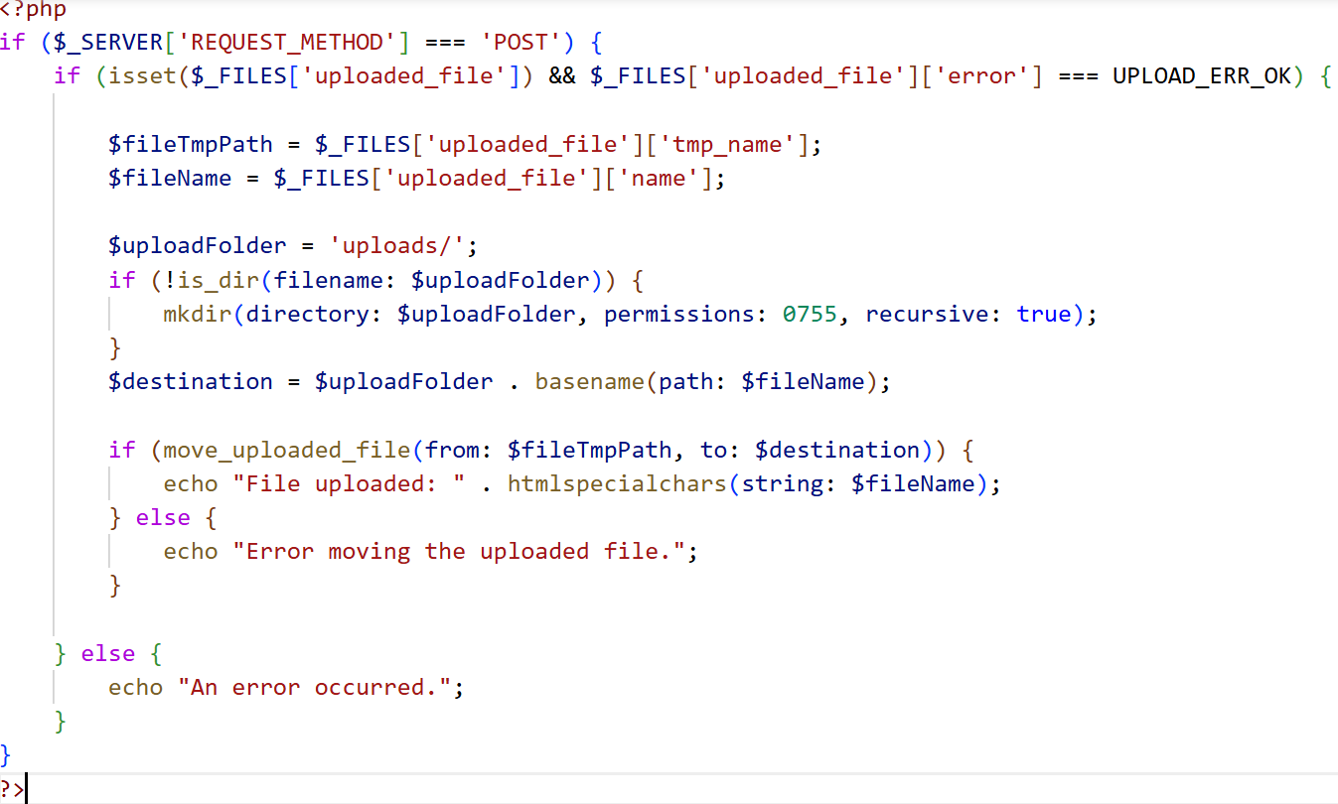

Slide 27
The if ($_SERVER['REQUEST_METHOD'] === 'POST') block checks if the request is a POST request and if a file is present in the uploaded_file property.
Next, we define a uploads/ folder and creates it if it doesn’t exist. The code then constructs the final path where the uploaded file will be saved, using the original filename.
Finally, we move the file from its temporary location on the server to a permanent location (the uploads folder).

Slide 28
THANK YOU
28

